Slide 1
Storage Management

Slide 2
Introduction
The main mass-storage system in modern computers is secondary storage, which is usually provided by hard disk drives (HDD) and nonvolatile memory (NVM) devices.
Some systems also have slower, larger, tertiary storage, generally consisting of magnetic tape, optical disks, or even cloud storage.

Slide 3
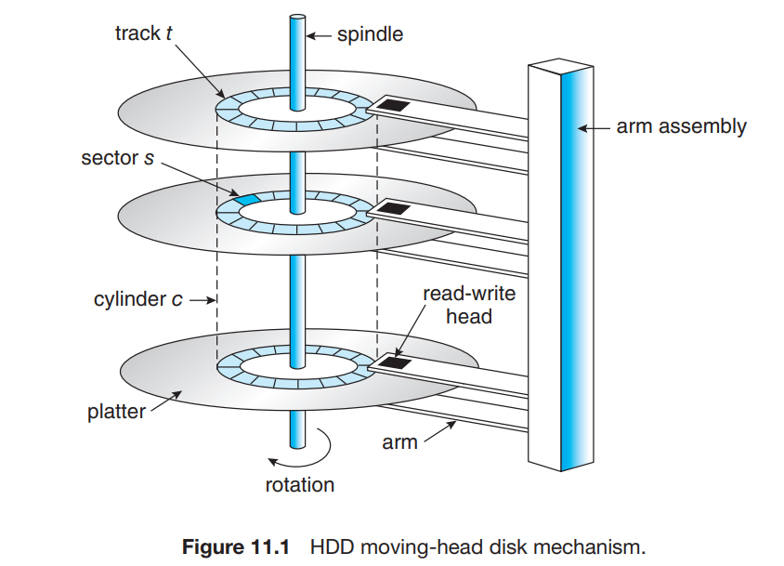
1 ) Overview of Mass-Storage Structure(Hard Disk Drives)

Slide 4
HDDs are relatively simple .
Each disk platter has a flat circular shape, like a CD. Common platter diameters range from 1.8 to 3.5 inches.
The two surfaces of a platter are covered with a magnetic material.
We store information by recording it magnetically on the platters, and we read information by detecting the magnetic pattern on the platters.
A read–write head “flies” just above each surface of every platter. The heads are attached to a disk arm that moves all the heads as a unit.
The surface of a platter is logically divided into circular tracks, which are subdivided into sectors.
The set of tracks at a given arm position make up a cylinder. There may be thousands of concentric cylinders in a disk drive, and each track may contain hundreds of sectors.

Slide 5
The transfer rate is the rate at which data flow between the drive and the computer.
Another performance aspect,
  the positioning time, or random-access time, consists of two parts:
    the time necessary to move the disk arm to the desired cylinder, called the seek time,
    and the time necessary for the desired sector to rotate to the disk head, called the rotational latency

Slide 6
2) HDD Scheduling
Disk scheduling algorithms manage the order in which disk I/O requests are processed, aiming to optimize disk utilization and minimize access time
They include :
  FCFS disk scheduling
  SCAN
  C- SCAN

Slide 7
2.1 FCFS Scheduling
FCFS is the simplest of all Disk Scheduling Algorithms. In FCFS, the requests are addressed in the order they arrive in the disk queue.
Advantages of FCFS
  Every request gets a fair chance
  No indefinite postponement
Disadvantages of FCFS
  Does not try to optimize seek time
  May not provide the best possible service

Slide 8
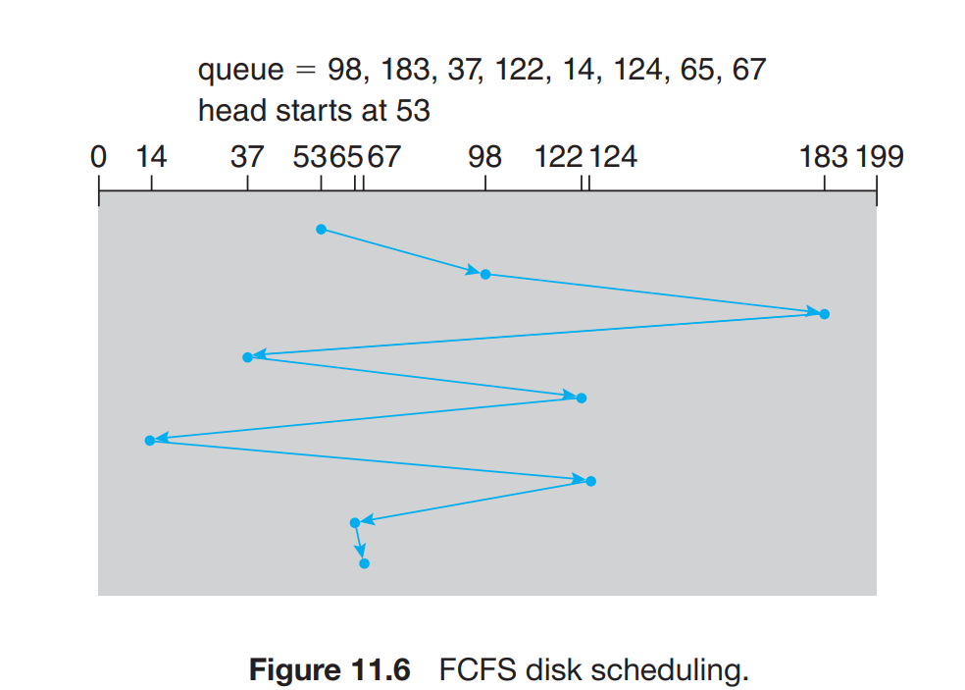
Consider, for example, a disk queue with requests for I/O to blocks on cylinders 98, 183, 37, 122, 14, 124, 65, 67, in that order. If the disk head is initially at cylinder 53,Apply FCFS disk scheduling .

Slide 9
So, total overhead movement (total distance covered by the disk arm) =
(98-53)+(183-98)+(183-37)+(122-37)+(122-14)+(124-14)+(124-65)+(67-65)
=640 cylinders

Slide 10
2.2 SCAN disk scheduling
In the SCAN algorithm, the disk arm starts at one end of the disk and moves toward the other end, servicing requests as it reaches each cylinder, until it gets to the other end of the disk.
At the other end, the direction of head movement is reversed, and servicing continues. The head continuously scans back and forth across the disk.
The SCAN algorithm is sometimes called the elevator algorithm, since the disk arm behaves just like an elevator in a building, first servicing all the requests going up and then reversing to service requests the other way.

Slide 11
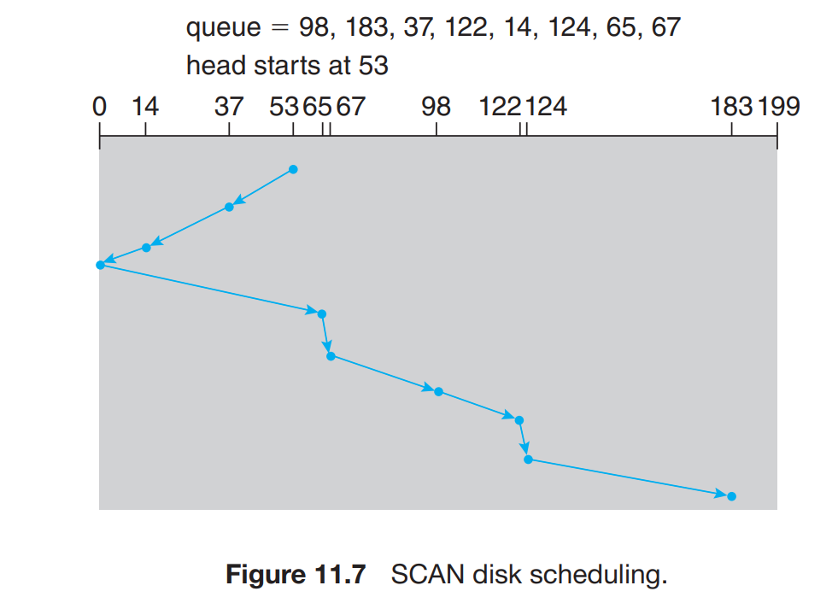
Consider, for example, a disk queue with requests for I/O to blocks on cylinders 98, 183, 37, 122, 14, 124, 65, 67, in that order. If the disk head is initially at cylinder 53,Apply SCAN disk scheduling .

Slide 12
So, total overhead movement (total distance covered by the disk arm) =
(53-0)+(183-0)=236 cylinders

Slide 13
2.3 C-SCAN disk scheduling
Circular SCAN (C-SCAN) scheduling is a variant of SCAN designed to provide a more uniform wait time.
Like SCAN, C-SCAN moves the head from one end of the disk to the other, servicing requests along the way.
When the head reaches the other end, however, it immediately returns to the beginning of the disk without servicing any requests on the return trip.

Slide 14
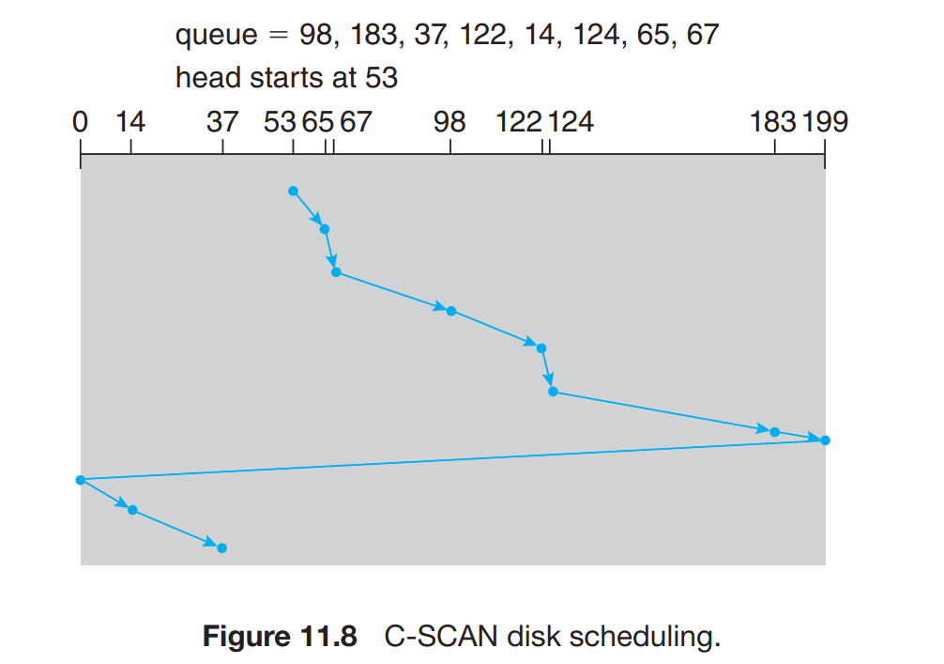
Consider, for example, a disk queue with requests for I/O to blocks on cylinders 98, 183, 37, 122, 14, 124, 65, 67, in that order. If the disk head is initially at cylinder 53,Apply C- SCAN disk scheduling .

Slide 15
So, total overhead movement (total distance covered by the disk arm) =
(199-53)+(199-0)+(37-0)
=382 cylinders.

